Slide 1
Module 3: Security
Unsupervised Learning for Network Anomaly Detection
ML for Cybersecurity
Fall 2020

Slide 2
Learning Objective

Slide 3
Learning Objectives
Describe the considerations and challenges around choosing how to represent network data for analysis and modeling
Load network traffic that has been collected into software libraries
Represent your network data in ways that can be inputted into machine learning models

Slide 4
Unsupervised Learning

Slide 5
Unsupervised Learning: Context and Goals
In contrast to making predictions from data, unsupervised learning seeks to discover patterns.
Data is unlabeled. Goal is thus to discover structure.
Unsupervised learning has two common applications:
Clustering
Dimensionality reduction (often can be used in conjunction with supervised learning)

Slide 6
Aspects of Unsupervised Learning
Often more difficult and complicated than supervised learning.
Challenging to evaluate because there is no “right answer”.
Things to consider:
Number of dimensions
Number of clusters
Quality of clusters

Slide 7
Examples of Unsupervised Learning in Networking
Principal Component Analysis (PCA)
Gaussian Mixture Models (GMM)
One-Class Support Vector Machines (OCSVM)
Kernel Density Estimation (KDE)
Independent Forest (IF)

Slide 8
























Slide 9
Principal Component Analysis

Slide 10
Traffic Anomaly Detection: Motivation
Many “actionable” changes to traffic patterns
DDoS attacks
Routing anomalies
Link failures
Flash crowds
…

Slide 11
Network-Wide Traffic Analysis
Anomaly Detection: Which links show unusual traffic?
Traffic Engineering: How does traffic move throughout the network?
Capacity planning: How much and where in network to upgrade?

Slide 12

Data Representation: Origin-Destination Flows
total traffic on the link
traffic
time
Link traffic arises from the superposition of Origin-Destination (OD) flows
A fundamental primitive for whole-network analysis
Notes:
OD flows account for routing and link failures. A fundamental primitive to study
MARK: I will replace that cartoon plot with a real data plot.

Slide 13
This is Complicated
Measuring and modeling traffic on all links simultaneously is challenging.
Even single link modeling is difficult
100s of links in large IP networks
High-Dimensional timeseries
Significant correlation in link traffic

Slide 14
How to Analyze OD Flows?
Even more OD flows than links
Still a high dimensional, multivariate timeseries
How do we extract meaning from this high dimensional structure in a systematic manner?

Slide 15
Approach: Dimensionality Reduction
Look for good low-dimensional representations
A high-dimensional structure can be explained by a small number of independent variables
A commonly used technique: Principal Component Analysis (PCA) (aka KL-Transform, SVD, …)

Slide 16
Summary
Measure complete sets of OD flow timeseries from two backbone networks
Use PCA to understand their structure
Decompose OD flows into simpler features
Characterize individual features
Reconstruct OD flows as sum of features
Call this structural analysis
Notes:
Our work is the first to study the properties of OD flows. We collect data from two backbone networks, the European portion of the Sprint Tier-1 backbone network and the Abilene backbone network. We then use a technique called Principal Component Analysis to understand the structure of OD flows.
To give some intuition here, our general strategy is to take the set of all OD flows from a network and decompose it systematically into a smaller set of primitive features, which are easier to understand. And then, armed with an understanding of these features, to re-assemble all the OD flows. Such a methodology can actually yield significant insight into the structure of all OD flows, which number in the hundreds.

Slide 17
Example Traffic Flows: Timeseries Data
Some have visible structure, some less so…
Notes:
So having done all this data processing, here are example of some sample OD flows.

Slide 18
Structural Analysis
Are there low dimensional representations for a set of OD flows?
Do OD flows share common features?
What do the features look like?
Can we get a high-level understanding of a set of OD flows in terms of these features?
Notes:
netflow

Slide 19
Principal Component Analysis
Original Data
Transformed Data
PC2
PC1
x2
PC2
x2
u2
u1
u2
PC1
u1
x1
x1
x1 , x2
u1 , u2
Notes:
At its heart PCA is a coordinate transformation method, best shown by an example.
On the left we have some data in their original axis representation, an XY axis. The data is a set of correlated rv as defined by this ellipse here.
PCA works by finding a new set of axis to describe this data, called the pc axis.
These axis have two special properties:
First, each PC axis captured the max energy in the data. And second, they are orthogonal to each other.
Ex, PC1 here basically amounts to a linear regression of the 2d data.
Once these axis are formed, each ponit x1 x2 in the original data can be now described in the new coordinate space, formed by the pc axis, as u1 u2.
All we’ve done therefore is to find a new set of axis and map the original data in the new axis.

Slide 20
Properties of Principle Components
Each PC in the direction of maximum (remaining) energy in the set of OD flows
Ordered by amount of energy they capture
Eigenflow: set of OD flows mapped onto a PC; a common trend
Ordered by most common to least common
Notes:
Generalizinig this to OD flows is as follows.
Each PC captures the maximum energy in the data.
In this way, the PCs are ordered by the amount of energy they capture.
The transformed points, the u1 u2 in the last slide, are what we call eigenflows now. Each eigenflow is a mapping of the OD flows onto a PC. Therefore, each eigenflow is a timeseries that captures a trend common across all OD flows.
Because the PCs are ordered by their energy, the eigenflows are also ordered by importance – from the trend that’s most common to the trend that is least common in all the OD flows.

Slide 21
PCA on Traffic flows
# OD pairs
# OD pairs
# OD pairs
time
time
# OD pairs
OD flow
Eigenflow
PC
X:
V:
Principal matrix
OD flow
matrix
U:
Eigenflow matrix

Slide 22
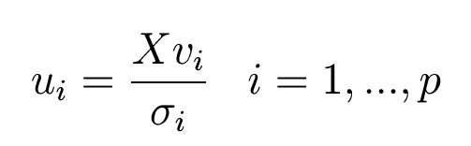



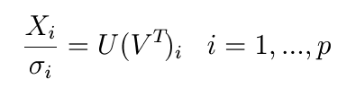
PCA on Traffic Flows
Each eigenflow is a weighted sum of all OD flows
Eigenflows are orthonormal
=
;
Singular values indicate the energy attributable to a principal component
Each OD flow is weighted sum of all eigenflows
=
+
+

Slide 23
Network Traffic is Inherently Low Dimensional
Small number of PCs capture most of signal’s structure
Plot of OD flow energy captured by each dimension.
Energy captured
Principal Components
Notes:
Recall that each principal component captures the maximum remainng energy in the data.
Therefore by inspecting how much energy is captured y each pc, we can gauge the true dimension of the OD flows.
Here, on the xaxis are the principalc omponents.
On the yaxis, the energy captured by them.
Whats surprising here is that evevn though there are so many od flows with such varied structure, about 10 dimensions capture all the energy of the data.

Slide 24
Structure of OD Flows
Most OD flows have less than 20 significant eigenflows
Can think of each OD flow as having only a small set of “features”
Notes:
Transition: What do these common features or eigenflows look like?

Slide 25
Reasons for Low Dimensionality
Generally, traffic on different links is dependent
Link traffic is the superposition of origin-destination flows (OD flows)
The same OD flow passes over multiple links, inducing correlation among links
All OD flows tend to vary according to common daily and weekly cycles, and so are themselves correlated
Notes:
But, even though there are hundreds of links, each with their own varied structure, there is a case to be made that link traffic really can be well described by fewer dimensions.
Two reasons
1) flows induced correlation.
2) OD flows

Slide 26
Approximating With Top 5 Eigenflows

Slide 27
Types of Eigenflows
Deterministic
d-eigenflows
Spike
s-eigenflows
Noise
n-eigenflows
Periodic trends
Sudden, isolated spikes and drops
Roughly stationary and Gaussian

Slide 28
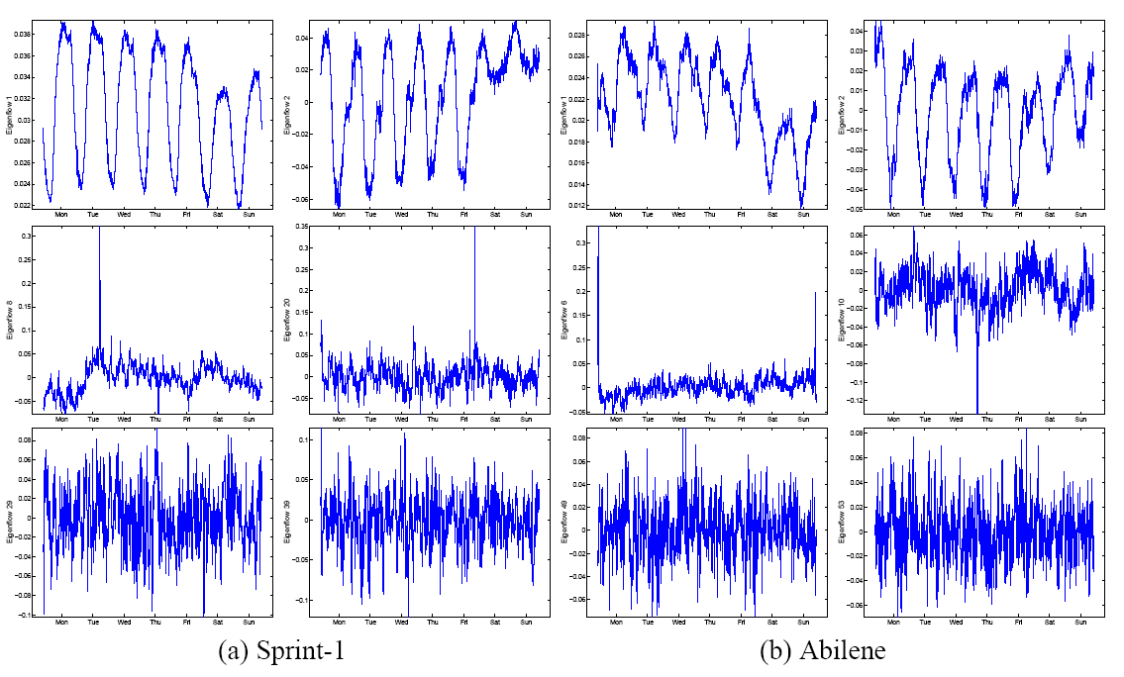
Hundreds of Eigenflows But Only Three Basic Types
Notes:
Here is an example of eigenflows. After visually inspecting the set of all eigenflows, three clear patterns emerged.
We have some eigenflows here that are periodic.
Some that have sharp sikes.
And these look roughly like noise.

Slide 29
An OD Flow, Reconstructed
OD flow
D-components
S-components
N-components

Slide 30
Application: Anomaly Detection
Is my network experiencing unusual conditions?
Then, adopt the following framework
Detection Is there an unusual event?
Identification Which of the possible explanations fits best?
Quantification How serious is the problem?
Notes:
Our work begins with the observation that the problems I just mentioned are all really special cases of the more basic and general question: is my network experiencing an unusual condition.
This is a pretty broad and difficult question and so to answer it, we separated it into 3-steps:
The first step is to detect when something has gone wrong.
The next step is to identify what exactly it is, perhaps an attack or an outage.
And the final step is to quantify its impact, and if its great, to alert operators so that the necessary mitigation steps can be taken.

Slide 31
DEMONSTRATION: Anomaly Detection

Slide 32
